Slide 1







Landing Success Prediction: Optimizing Space Y’s Rocket Reusability
A Data-Driven Approach to Reduce Costs and Enhance Launch Efficiency
Brian Robertson
10/18/2024

Slide 2
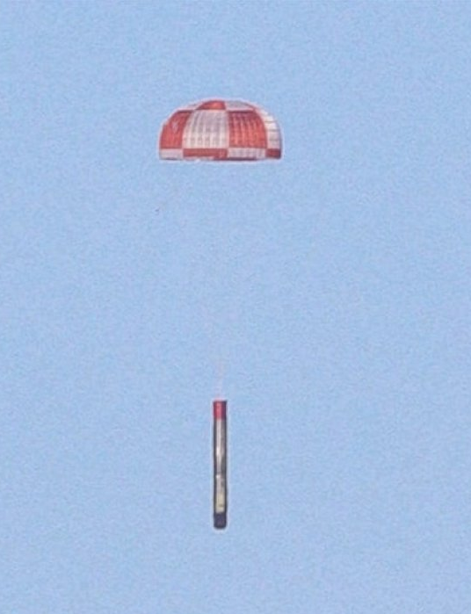


OUTLINE
Introduction
Problem Statement
Data Collection
Data Wrangling
Exploratory Data Analysis (EDA)
Machine Learning Models
Model Results & Performance
Business Implications
Challenges Encountered
Future Considerations
Conclusion
Appendix
Notes:
Executive Summary
Introduction
Methodology
Results
Visualization – Charts
Dashboard
Discussion
Findings & Implications
Conclusion
Appendix

Slide 3
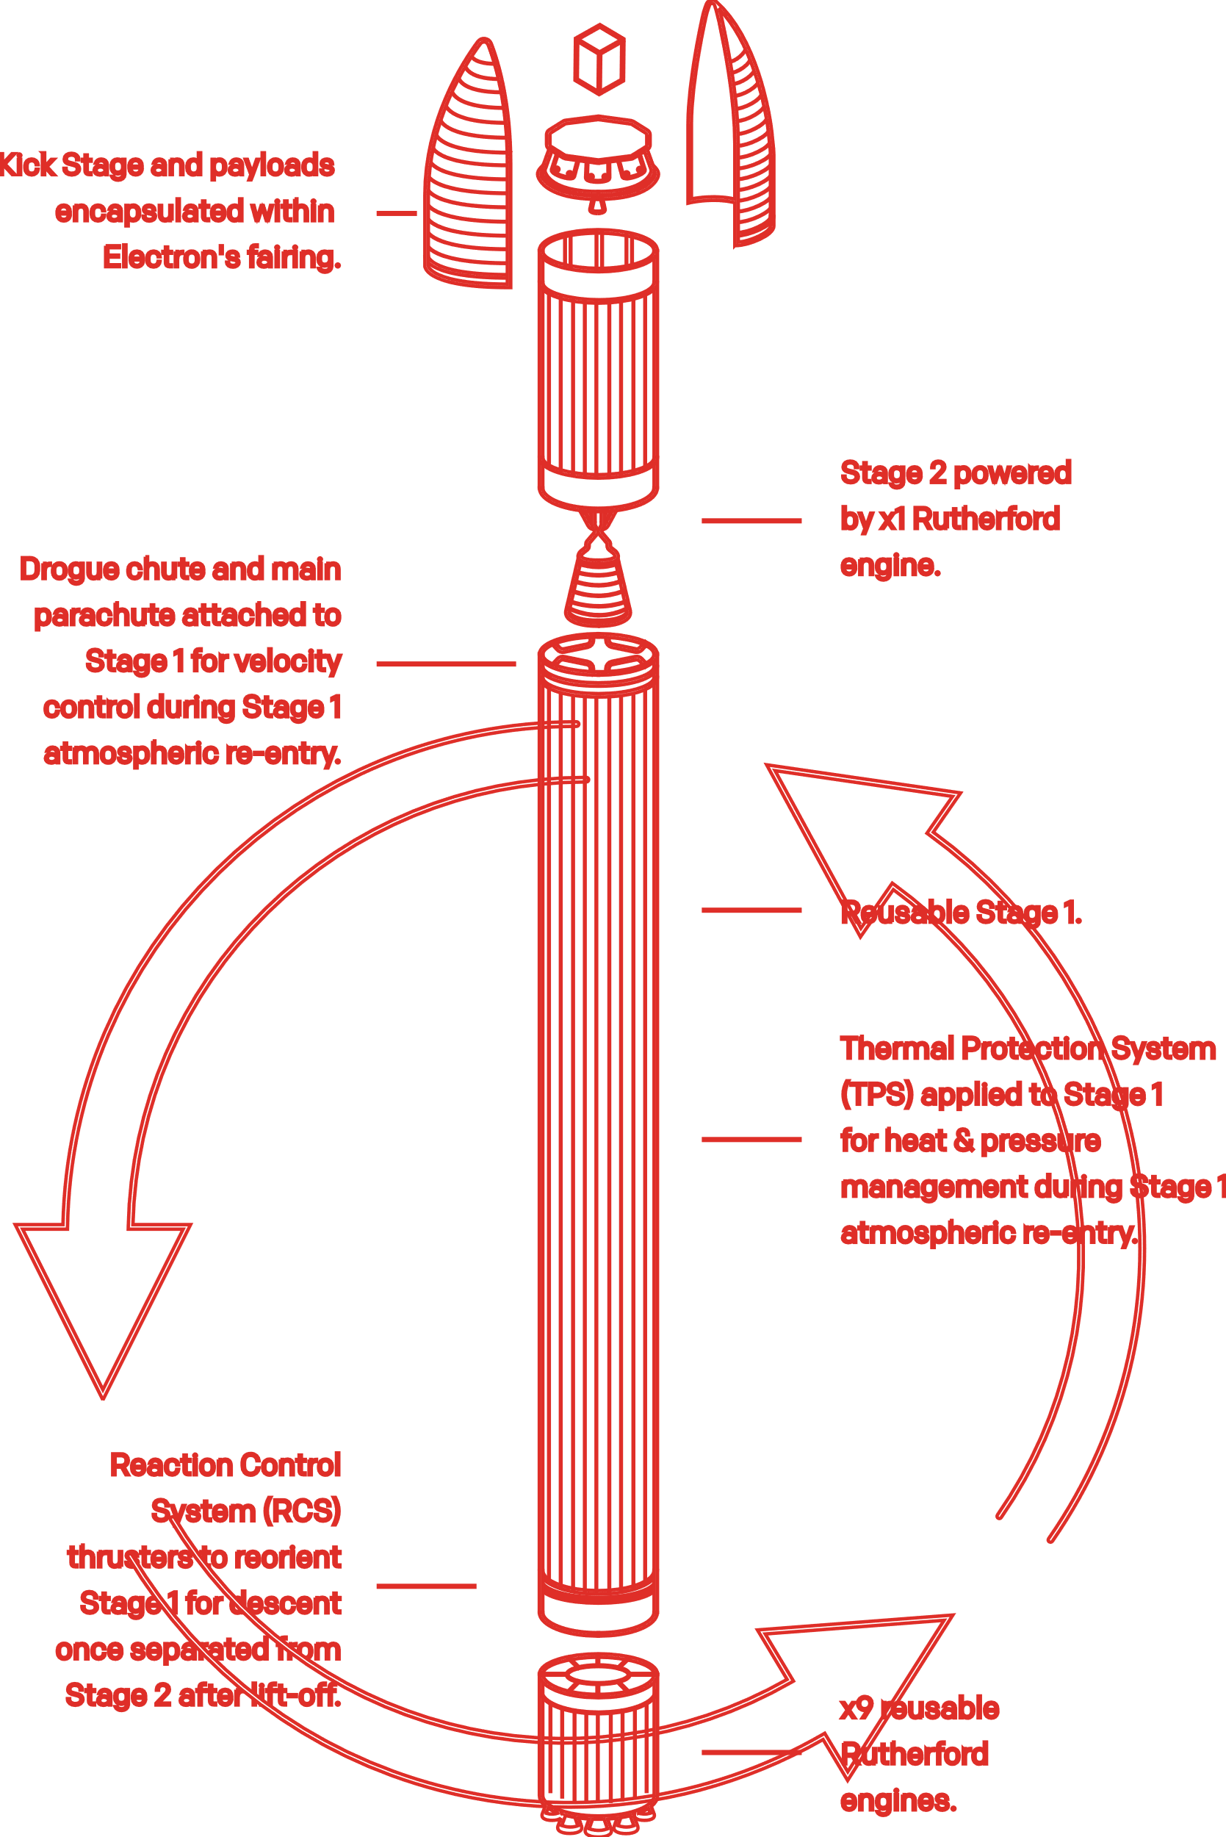
INTRODUCTION
SpaceX: Affordable space travel, reusable rockets, $62M per launch.
Competitors:
Virgin Galactic: Suborbital spaceflights.
Rocket Lab: Small satellite launches.
Blue Origin: Reusable sub-orbital and orbital rockets.
My Role at Space Y
Data Scientist at Space Y competing with SpaceX.
Using data science to predict first-stage landings.
Critical for pricing and competitive cost strategies.
Notes:
Background Information on SpaceX and the Competition
SpaceX, founded by Elon Musk, has revolutionized the space industry with groundbreaking achievements such as:
Launching spacecraft to the International Space Station.
Developing Starlink, a satellite internet service providing global connectivity.
Conducting manned missions into space.
What sets SpaceX apart is its ability to make space travel more affordable. A significant factor contributing to SpaceX’s cost-effectiveness is the reuse of its first-stage rockets. SpaceX’s Falcon 9 launches, for example, cost $62 million, which is substantially lower than competitors like Blue Origin, Rocket Lab, and Virgin Galactic, whose launches can cost up to $165 million per mission. Recovering and reusing the rocket's first stage plays a crucial role in these savings.
The Competition
Virgin Galactic focuses on providing suborbital spaceflights to make space tourism accessible to civilians.
Rocket Lab is a leading provider of small satellite launch services, specializing in delivering small payloads to space.
Blue Origin, founded by Jeff Bezos, builds reusable rockets, both sub-orbital and orbital, focusing on sustainability and long-term space exploration.
The Significance of Predicting First-Stage Landing Success
One key component in making space travel more affordable is predicting whether the first stage of a rocket can successfully land. This insight can help reduce the cost of each launch by determining whether the first stage can be recovered and reused. A failed landing means the stage is lost, leading to higher costs for future launches.
Your Role at SpaceY
In this project, I am a data scientist at Space Y, a new rocket company aspiring to compete with SpaceX, founded by Billionaire industrialist Allon Musk. Space Y seeks to challenge SpaceX’s dominance by creating cost-efficient launches. I aim to use data science techniques to predict the success of SpaceX’s Falcon 9 first-stage landings. This analysis will help SpaceY determine the likelihood of recovering the first stage, which is crucial for pricing and cost-saving strategies.
Understanding when the first stage will land successfully will allow SpaceY to price launches more competitively, optimize recovery strategies, and ultimately reduce the cost of space missions.
This project involves gathering data on past launches, exploring trends, and applying machine learning models to predict the likelihood of success, which could significantly impact our competitive edge in the space industry.
https://www.rocketlabusa.com/launch/reusable-rockets/

Slide 4
Problem Statement
Space Y is striving to optimize rocket reusability, similar to SpaceX’s success in reducing launch costs by recovering the first stage. The goal is to predict the likelihood of a successful landing, enabling Space Y to make data-driven decisions, minimize launch costs, and remain competitive.

Slide 5

EXECUTIVE SUMMARY
The goal is to predict the cost and success rate of SpaceX launches based on historical data.
Methods used:
EDA, SQL queries, visualizations, machine learning models.
Key findings:
The success rate of launches increases after 2013, and SpaceX’s first stage reuse has a strong impact on reducing costs.

Slide 6
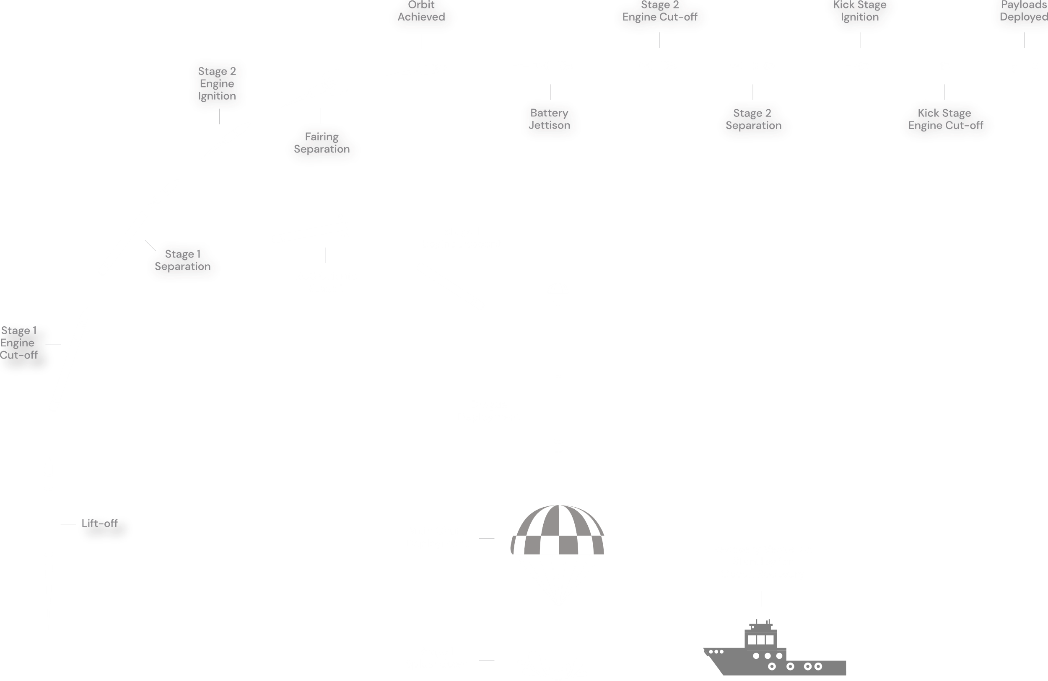
Notes:
https://www.rocketlabusa.com/launch/reusable-rockets/

Slide 7

METHODOLOGY: Data Collection & Wrangling
Data Collection
Sources: SpaceX APIs: Real-time mission data.
Web Scraping: Extracted historical data.
CSV Files: Pre-processed datasets:
dataset_part_1.csv
dataset_part_2.csv
dataset_part_3.csv
Data Wrangling
Cleaning:
Handled missing values and inconsistencies.
Feature Engineering:
Extracted year from Date for trend analysis.
Encoding:
Applied OneHotEncoding to categorical variables (e.g., Orbit, LaunchSite).
Notes:
Data Collection:
SpaceX API: SpaceX provides open APIs that allowed us to gather real-time data, which was key to getting up-to-date mission information.
Web Scraping: I used Python's BeautifulSoup to scrape historical mission data from reliable sources (like Wikipedia).
CSV Files: Pre-processed datasets like dataset_part_2.csv and dataset_part_3.csv gave us structured data to kickstart the project. These datasets included information on rocket launches, payload mass, and success rates.
Data Wrangling:
Missing Data: I dealt with missing values through imputation and removed irrelevant columns where necessary.
Feature Engineering: Extracting the year from the 'Date' column helped us track trends in rocket launches and analyze success over time.
OneHotEncoding: I used OneHotEncoding to make categorical variables like Orbit, LaunchSite, and Serial usable for machine learning models.
Emphasize the diversity of data sources, showing my comprehensive approach to gathering data.
Highlight challenges like handling missing values and creating new features from the existing data.

Slide 8
METHODOLOGY: Machine Learning Models
Models & Techniques
Logistic Regression
Decision Trees
K-Nearest Neighbors (KNN)
Support Vector Machines (SVM)
Optimization
Used GridSearchCV for hyperparameter tuning.
Cross-Validation (cv=10) for accuracy improvement.
Notes:
Logistic Regression:
Logistic regression helped us understand the probability of a successful first-stage landing based on multiple input factors. It’s straightforward but effective for binary classification tasks like ours (success/failure).
Decision Trees:
This model helped me visualize decision paths and identify the most influential factors in determining landing success. It’s interpretable and allows us to understand why certain launches succeed or fail.
K-Nearest Neighbors (KNN):
KNN was used to group similar rocket launches based on attributes like payload mass and launch site, allowing me to predict success based on “neighboring” launches.
Support Vector Machines (SVM):
SVM was effective for finding the best boundary to classify successful vs. failed launches, especially when the data was not linearly separable.
GridSearchCV & Cross-Validation:
I used GridSearchCV to find the best hyperparameters for each model, improving model accuracy.
Cross-validation (cv=10) ensured that our models were robust and did not overfit the training data. Emphasize that GridSearchCV was vital in selecting the best model parameters to optimize performance.
Discuss trade-offs between the models: for instance, while decision trees provide interpretability, SVM often provides more accuracy for complex datasets.
Highlight that multiple models were explored to ensure that the final prediction is as accurate and robust as possible.

Slide 9
RESULTS
Notes:
Descriptive Statistics & EDA: Present key insights using visualizations. You’ve done scatter plots (Flight Number vs. Payload Mass), bar charts (Success rate per orbit), and other EDA charts. Mention any trends you noticed, such as increased success rates after 2013.SQL Results: Provide an overview of SQL queries that determined insights like the total number of launches per site, success/failure outcomes, and maximum payload masses.

Slide 10
PROGRAMMING LANGUAGE TRENDS
Current Year
Next Year
<Bar chart of top 10 programming languages for the current year goes here.>
< Bar chart of top 10 programming languages for the next year goes here.>

Slide 11
PROGRAMMING LANGUAGE TRENDS - FINDINGS & IMPLICATIONS
Findings
Finding 1
Finding 2
Finding 3
Implications
Implication 1
Implication 2
Implication 3

Slide 12
DATABASE TRENDS
Current Year
Next Year
< Bar chart of top 10 databases for the current year goes here >
< Bar chart of top 10 databases for the next year goes here.>

Slide 13
DATABASE TRENDS - FINDINGS & IMPLICATIONS
Findings
Finding 1
Finding 2
Finding 3
Implications
Implication 1
Implication 2
Implication 3

Slide 14

DASHBOARD
<The GitHub link of the Cognos dashboard goes here.>

Slide 15
DASHBOARD TAB 1
Screenshot of dashboard tab 1 goes here

Slide 16
DASHBOARD TAB 2
Screenshot of dashboard tab 2 goes here

Slide 17
DASHBOARD TAB 3
Screenshot of dashboard tab 3 goes here

Slide 18
Model Performance & Key Insights
Visual: Bar chart comparing model accuracies and/or confusion matrix for the best-performing model.
Logistic Regression and Decision Trees showed higher accuracy compared to KNN and SVM.
Confusion matrix highlights model's ability to predict success vs. failure effectively.
Notes:
Discussion Slide Model Performance & Key Insights
Model Performance & Key Insights
Performance of models (Logistic Regression, Decision Trees, KNN, SVM) in predicting first-stage landing success.
Highlight the best-performing models based on accuracy and confusion matrices.
Explain why certain models performed better (e.g., hyperparameter tuning or dataset characteristics).
Link these findings to cost-saving strategies and how predicting success impacts Space Y’s ability to reuse rockets efficiently.
Challenges Encountered
Data collection and cleaning challenges (e.g., handling missing data, web scraping issues).
Challenges in model training (e.g., difficulty in tuning hyperparameters, balancing the dataset).
Steps taken to overcome these obstacles (e.g., data wrangling techniques, model adjustments).
Future Considerations
Discuss potential for future enhancements, such as using more advanced models (e.g., neural networks).
Explore additional features or data sources to further improve prediction accuracy.
Consider developing more sophisticated pricing models based on the success of future launches.
Include charts comparing the performance of the models (e.g., a bar chart or a table showing accuracy scores for Logistic Regression, Decision Trees, KNN, SVM).A confusion matrix visual for the best-performing model can be helpful.

Slide 19
Business Implications of Landing Predictions
Visual: Comparison bar chart showing reusable vs. non-reusable launch costs, or a competitive landscape graphic.
Findings
Finding 1
Finding 2
Finding 3
"Accurate landing predictions can lead to significant cost savings and maintain competitive advantage."
Notes:
Overall Findings & Business Implications:
"By accurately predicting first-stage landings, Space Y could save millions per launch, bringing down costs below competitors like Rocket Lab and Blue Origin.“
"This model's predictions directly impact Space Y's pricing strategies, allowing us to undercut market prices."
Impact on Space Y’s Business Strategy
Accurate landing predictions can directly impact Space Y's ability to cut costs by reusing first stages.
Discuss how Space Y can leverage this analysis to create competitive pricing strategies, similar to SpaceX’s affordable launches.
Potential for Space Y to compete with Blue Origin, Rocket Lab, and Virgin Galactic by optimizing reusability and reducing launch costs.
Optimizing Rocket Launches
Using the machine learning models to predict successful landings enables Space Y to optimize the reuse of rockets, potentially reducing launch costs by millions.
Accurate predictions allow Space Y to better plan for payload and mission-specific requirements, giving them a competitive edge.
A visual showing potential cost savings if the first stage of the rocket is reused (e.g., a comparison bar chart between reusable vs. non-reusable launches).A visual depicting the competition landscape (e.g., a graphic showing SpaceX, Blue Origin, Rocket Lab, and Space Y's potential positioning).

Slide 20

Summary & Next Steps
Visual: A summary infographic or a clean bullet-point list summarizing key takeaways.
Accurate landing predictions enable cost savings.
Future improvements could increase accuracy further.
Notes:
"The analysis shows that accurate landing predictions allow Space Y to optimize launch operations and reduce costs.""With more data and advanced models, Space Y can further enhance its predictive capabilities.“
Summary: Machine learning models provide an effective way to predict the success of first-stage rocket landings, which is crucial for cost optimization and business strategy.
Business Value: Space Y can use these models to reduce costs, enhance reusability, and compete effectively in the growing space industry.
Next Steps: Incorporate more complex models, explore new data sources, and refine pricing strategies based on model predictions. Continue improving predictive accuracy to support future rocket launches and drive innovation for Space Y.
A summary chart or infographic summarizing the key findings or takeaways.

Slide 21

Supporting Data
Include any relevant additional charts, or tables that you may have created during the analysis phase.
Notes:
Add additional SQL queries, charts, or code snippets from your Jupyter Notebooks here.

Slide 22
JOB POSTINGS
In Module 1 you have collected the job posting data using Job API in a file named “job-postings.xlsx”. Present that data using a bar chart here. Order the bar chart in the descending order of the number of job postings.

Slide 23
POPULAR LANGUAGES
In Module 1 you have collected the job postings data using web scraping in a file named “popular-languages.csv”. Present that data using a bar chart here. Order the bar chart in the descending order of salary.

